Slide 1

Data Model and Relationships

Slide 2
Outline
Data Model
01
Normalisation
02
Table Relationships
03

Slide 3
Data Model
A data model is a structured framework that defines how information is organized, stored, and connected within a database or analytics tool like Power BI.
You can think of it as the architectural blueprint for your data. Just as a library cataloging system dictates how authors, subjects, and call numbers relate to a physical book, a data model tells your software exactly how different spreadsheets or tables relate to one another.

Slide 4

components of DATA MODEL
A clean model ensures that when you drag "Branch Name" and "Total Fines" onto a Power BI canvas, the software immediately calculates the correct numbers without duplicating records or producing errors.
Entities (Tables): The distinct concepts or events you are tracking, such as Patrons, Library Items, or Circulation Transactions.
Attributes (Columns): The specific characteristics describing those entities, such as Patron Type, Publication Year, or Checkout Date.
Relationships (Links): The defined connections between the tables. For example, a relationship connects the “Accession No" in a checkout log to the identical " Accession No " in the book inventory table.

Slide 5
Fact and dimension tables
Feature | Fact Table | Dimension Table
Core Purpose | Records business events or transactions. | Provides descriptive context for the events.
Data Types | Primarily numbers, quantitative metrics, and IDs. | Primarily text, categories, and descriptive labels.
Keys Used | Contains Foreign Keys linking to dimension tables. | Contains a Primary Key (a unique identifier).
Growth Rate | Grows rapidly with daily operations (tall and narrow). | Grows slowly and remains relatively stable (short and wide).
Example | “FACT_Circulation” (Checkout ID, Fine Amount, Renewal Count). | DIM_Patron (Patron Name, Demographic, Library Card Type).

Slide 6
DOWNSIDE OF USING A FLAT TABLE
Massive Data Duplication (Bloat): If a patron checks out 100 books a year, a flat table forces you to repeat their name, email, and demographic information 100 separate times. This redundant text creates unnecessarily large files that drag down performance.
Update Nightmares (Anomalies): If a book's collection type changes from "New Arrivals" to "General Fiction," a flat table requires you to find and update every single historical checkout row for that book.
Sluggish Filtering: Power BI is specifically engineered to filter small, distinct dimension tables quickly, which then pass those filters down to the heavy fact table.

Slide 7
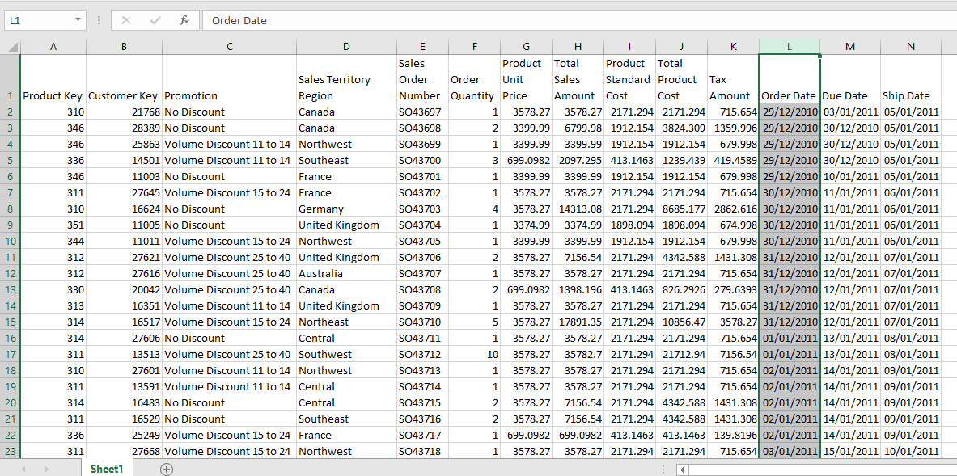
Example 1

Slide 8
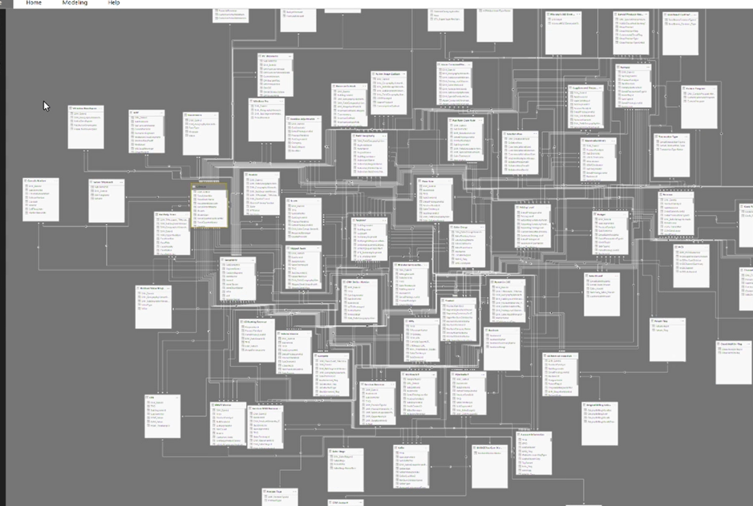
Example 2

Slide 9
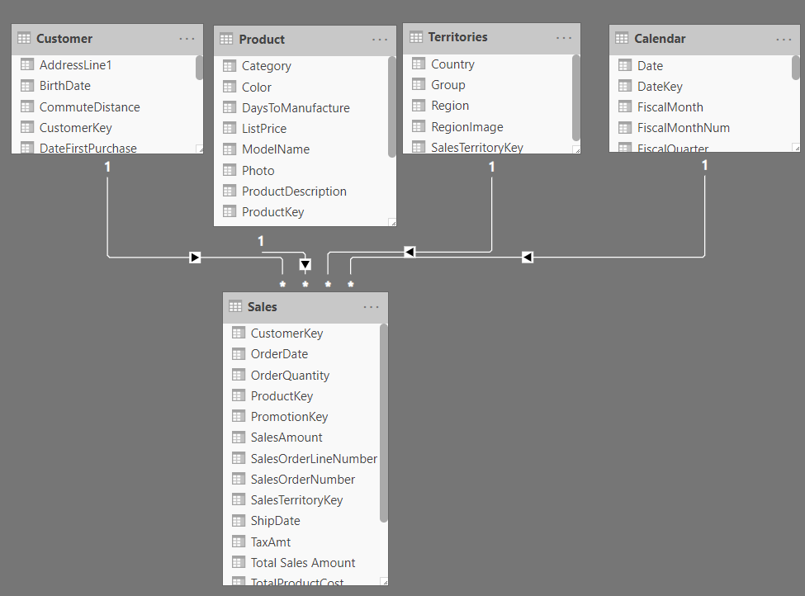
Example 3

Slide 10
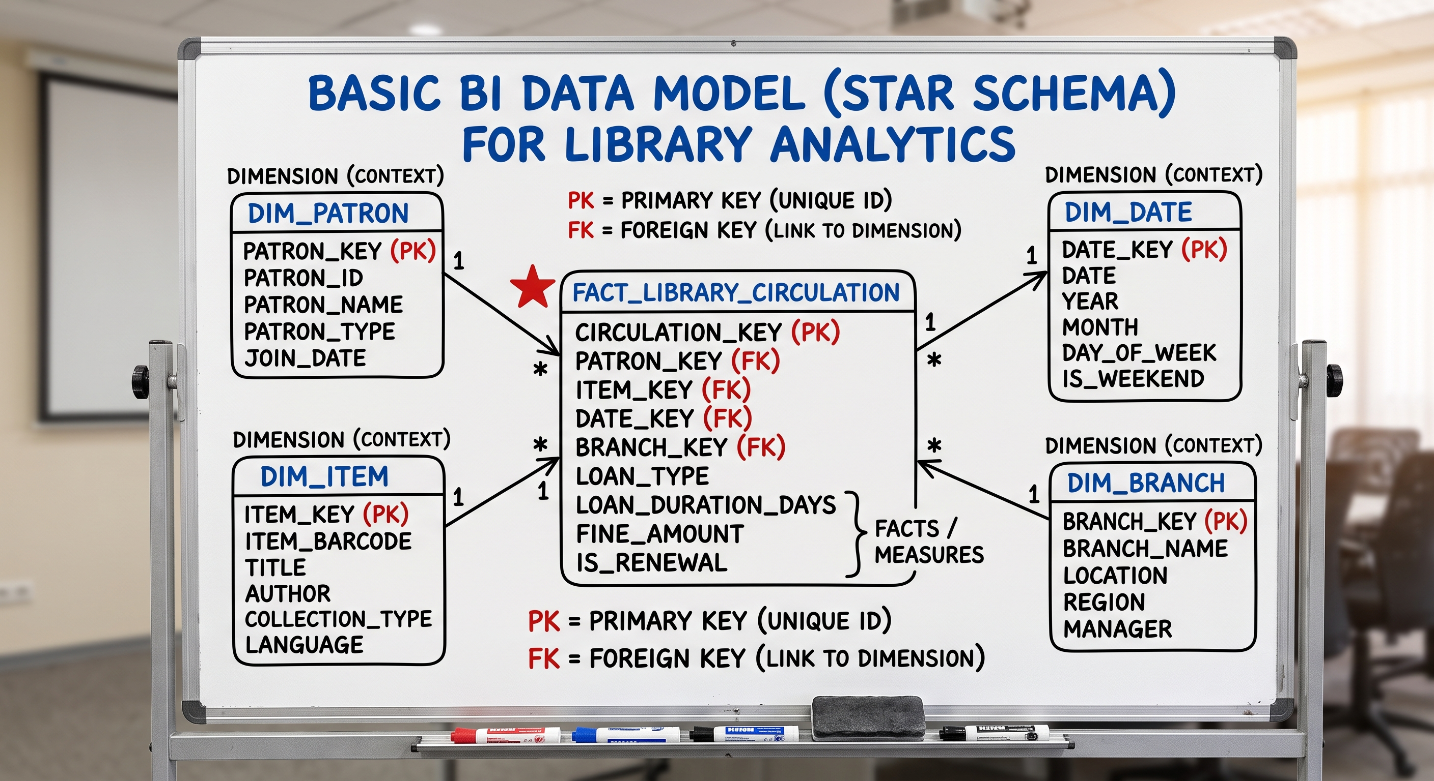
Example 4: STAR SCHEMA

Slide 11
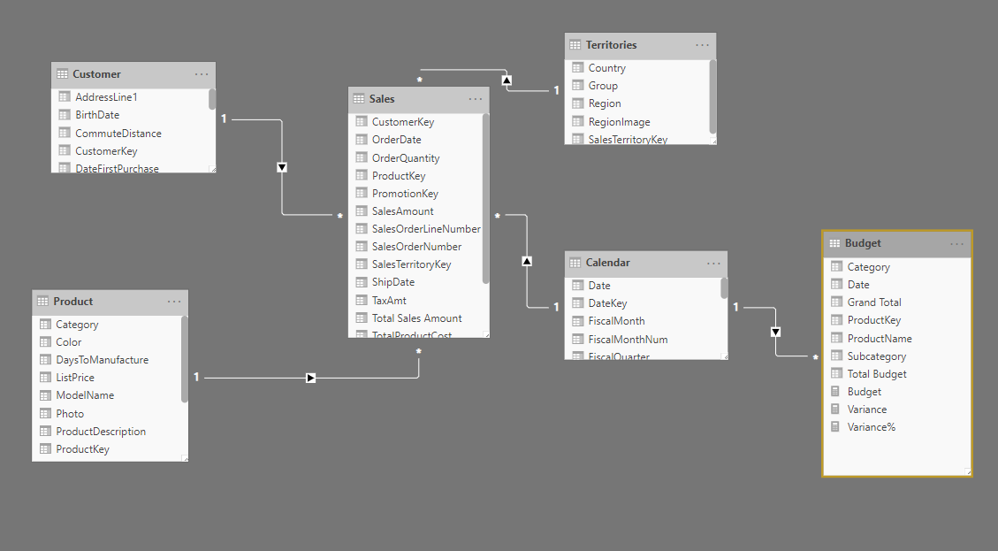
Example 4: Snowflake SCHEMA

Slide 12
normalisation
Normalization is the process of organizing data to minimize redundancy and protect data accuracy by dividing large tables into smaller, related ones.
  Eliminating Redundant Data: Instead of typing "University Faculty" 5,000 times in your main patron list, you store that text exactly once in a separate DIM_PatronType lookup table. You then connect it to the main patron table using a small numerical ID.
  Protecting Data Integrity: If the library needs to update a category name from "Juvenile" to "Young Adult", you only change one single cell in the isolated dimension table. Because of the established relationship links, that update instantly applies to every associated patron across your entire reporting dashboard.

Slide 13
NORMAL FORMS
First Normal Form (1NF): The table holds only single, atomic values in each cell. It eliminates repeating lists of information, and every column must have a unique name.
Second Normal Form (2NF): The table meets 1NF criteria and eliminates partial dependencies. Every non-prime attribute (attributes not part of the primary key) must be fully dependent on the complete primary key. Subsets of data applying to multiple rows are moved to separate tables.
Third Normal Form (3NF): The table meets 2NF criteria and removes transitive dependencies. Columns that do not directly depend on the primary key are isolated into separate tables.

Slide 14
Why normalisation?
“Clean” up the data
Ensure a proper structure of the data
Data consistency (easy to retrieve and input data, better chance to quickly search for data)
Increase quality of the data

Slide 15
Example
Insertion problem adding another book – repeat the data again
Deletion problem – the branch information is gone
Modification problem– you must change all the book records
BOOK REGISTER
Accession No | Book | Branch | Librarian | Office_tell
172344 | Peoples and Culture | Leeds | Mr. A Mr. B | 087545625
170233 | History of Human | Leeds | Mr. A Mr. B | 087545625
178964 | Plant Anatomy | Leeds | Mr. A | 087545625
173564 | Financial Accounting | Leeds | Mr. A Mr. B | 087545625

Slide 16
Solve with Normalisation
BOOK REGISTER
Accession No | Book | Branch | Librarian | Office_tell
172344 | Peoples and Culture | Leeds | Mr. A Mr. B | 087545625
170233 | History of Human | Leeds | Mr. A Mr. B | 087545625
178964 | Plant Anatomy | Leeds | Mr. A | 087545625
173564 | Financial Accounting | Leeds | Mr. A Mr. B | 087545625
Accession No | Book | Branch
172344 | Peoples and Culture | Leeds
170233 | History of Human | Leeds
178964 | Plant Anatomy | Leeds
173564 | Financial Accounting | Leeds
Branch | Librarian | Office_tell
Leeds | Mr. A Mr. B | 087545625
BOOK REGISTER
BRANCH TABLE

Slide 17
Relationships in power bi

Slide 18
Types of relationship
One to Many
One to One
Many to Many (Try as much as possible to avoid)
Direction of relationships
Single (ensure to check for the correct direction)
Both
Power BI will do this for you; make sure you check them and change them if necessary
https://www.youtube.com/watch?v=NvrpuBAMddw

Slide 19
THANK YOU

